Slide 1

8th Grade Math: Pre-Algebra
Unit 9, Lesson 7 Dilations Volume 2, pg. 92

Slide 2


Benchmark
MA.8.GR.2.2
Given a preimage and image generated by a single dilation, identify the scale factor that describes the relationship.
volume 2, pg. 92

Slide 3
Integrated Mathematical Thinking and Reasoning Standards
MA.K12.MTR.1.1 Actively participate in effortful learning both individually and collectively.
MA.K12.MTR.2.1 Demonstrate understanding by representing problems in multiple ways.
MA.K12.MTR.4.1 Engage in discussions that reflect on the mathematical thinking of self and others.
MA.K12.MTR.5.1 Use patterns and structure to help understand and connect mathematical concepts.
volume 2, pg. 92

Slide 4

Learning Targets
I can describe the effect on an image given the scale factor.
I can relate dilations to proportions.
volume 2, pg. 92

Slide 5

Warm-Up
volume 2, pg. 93

Slide 6
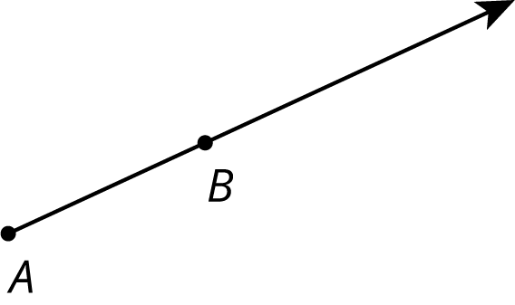

9.7.1 Warm-Up: Points on a Ray
A ray is shown with points $A$ and $B$ labeled.
Find a point on the ray whose distance from $A$ is twice the distance from $B$ to $A$. Label the point $C$.
Find a point on the ray whose distance from $A$ is half the distance from $B$ to $A$. Label the point $D$.
volume 2, pg. 93

Slide 7
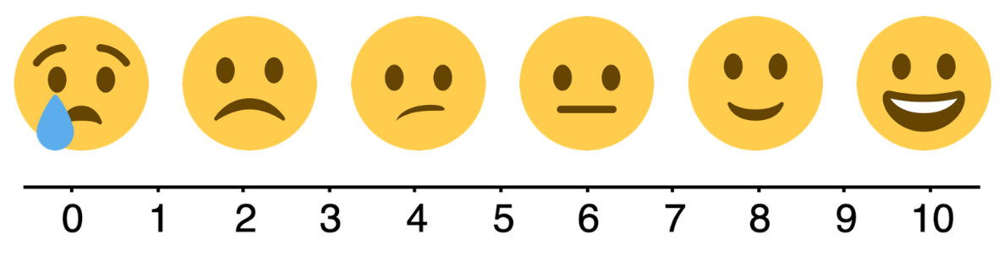
Use the emoji scale to rate your confidence in your placement of points $C$ and $D$ on the ray.
volume 2, pg. 93

Slide 8

Collaboration
volume 2, pg. 93

Slide 9

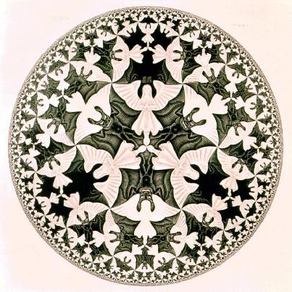
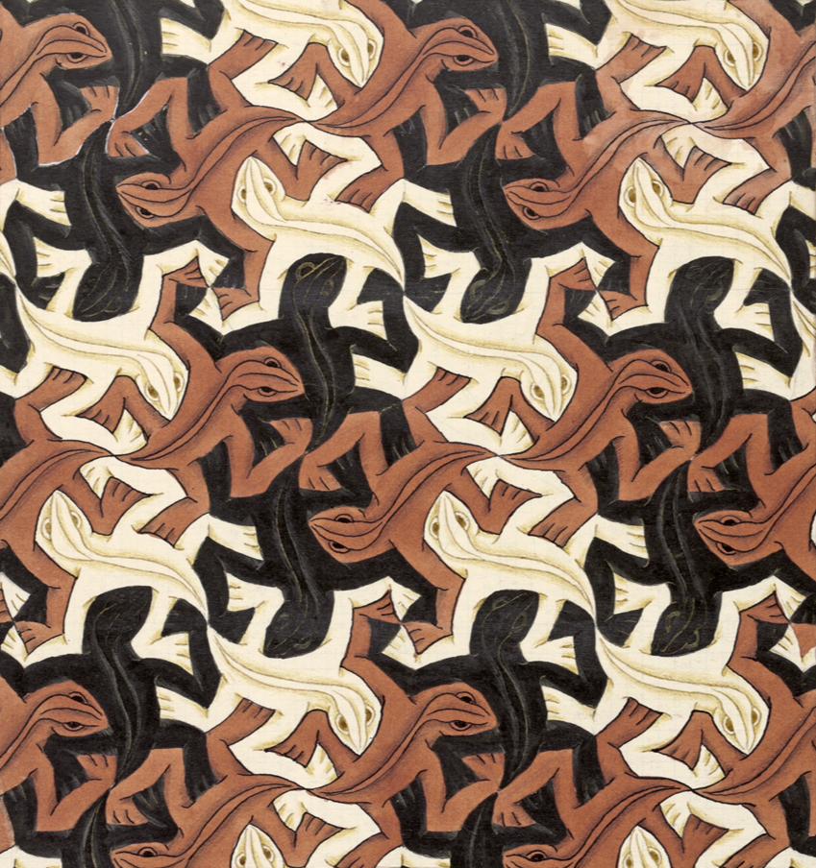
9.7.2 Collaboration: Artwork of M.C. Escher
M.C. Escher (1898-1972) was a Dutch artist whose work was inspired by mathematics. Though initially trained as an architect, he became one of the most famous and influential graphic artists in the world.
Below are two examples of Escher’s work.
Example A | Example B
volume 2, pg. 93

Slide 10
With your partner, discuss how the two example pieces shown are similar and different. Then, record at least two in each column.
Similarities | Differences
volume 2, pg. 93

Slide 11
Consider how the figures used to make the artwork were transformed.
Which of the art pieces could be created using only rigid transformations of the shapes used?
Explain how you know the other example could not be created from rigid transformations.
volume 2, pg. 94

Slide 12

Exploration
volume 2, pg. 94

Slide 13

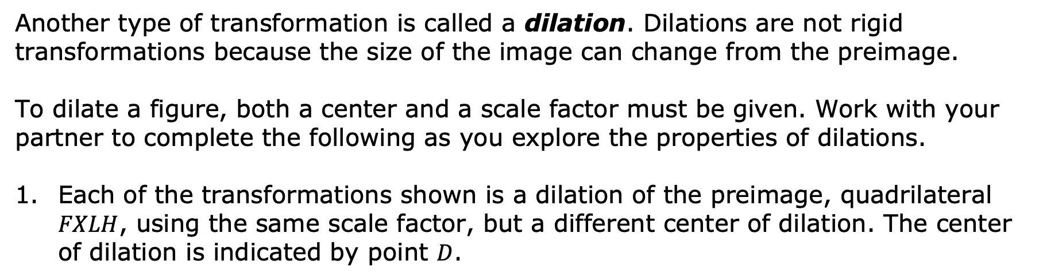
9.7.3 Exploration: Properties of Dilations
Another type of transformation is called a dilation. Dilations are not rigid transformations because the size of the image can change from the preimage.
To dilate a figure, both a center and a scale factor must be given. Work with your partner to complete the following as you explore the properties of dilations.
Each of the transformations shown is a dilation of the preimage, quadrilateral $FXLH$, using the same scale factor, but a different center of dilation. The center of dilation is indicated by point $D$.
volume 2, pg. 94

Slide 14
Transformation A | Transformation B
Transformation C | Transformation D
volume 2, pg. 94

Slide 15
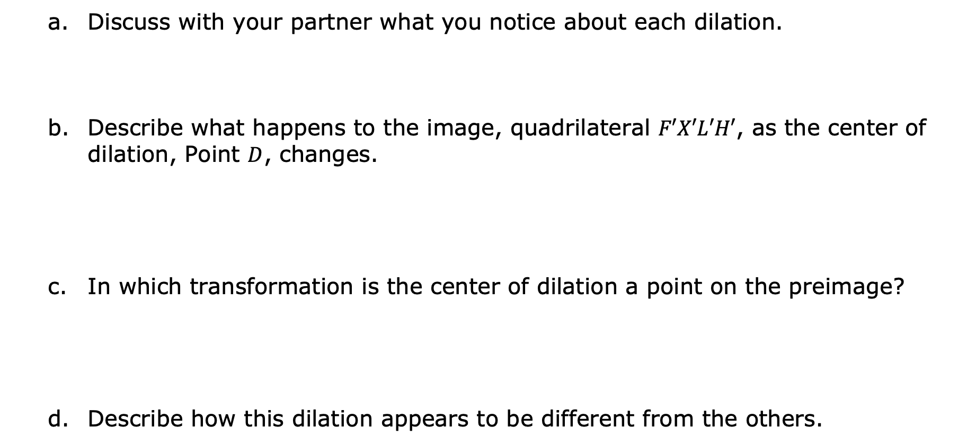
Discuss with your partner what you notice about each dilation.
Describe what happens to the image, quadrilateral $F′X′L′H′$, as the center of dilation, Point $D$, changes.
In which transformation is the center of dilation a point on the preimage?
Describe how this dilation appears to be different from the others.
volume 2, pg. 95

Slide 16
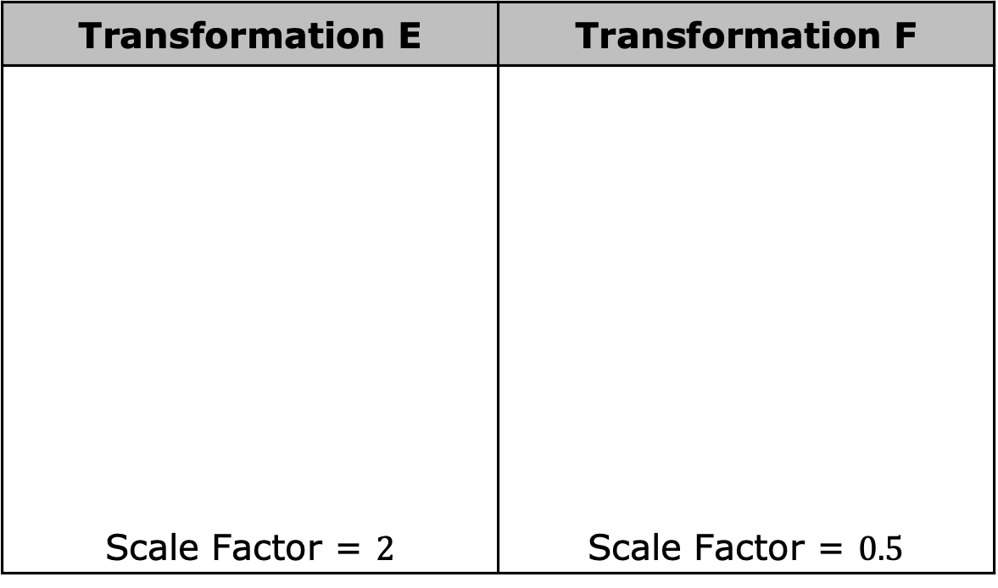
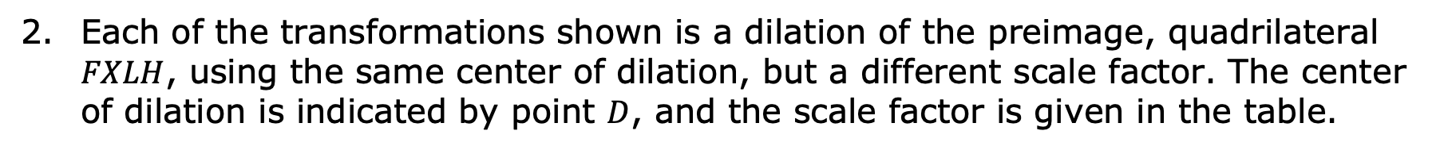
Each of the transformations shown is a dilation of the preimage, quadrilateral $FXLH$, using the same center of dilation, but a different scale factor. The center of dilation is indicated by point $D$, and the scale factor is given in the table.
Transformation E | Transformation F
Scale Factor = $2$ | Scale Factor = $0.5$
volume 2, pg. 95

Slide 17
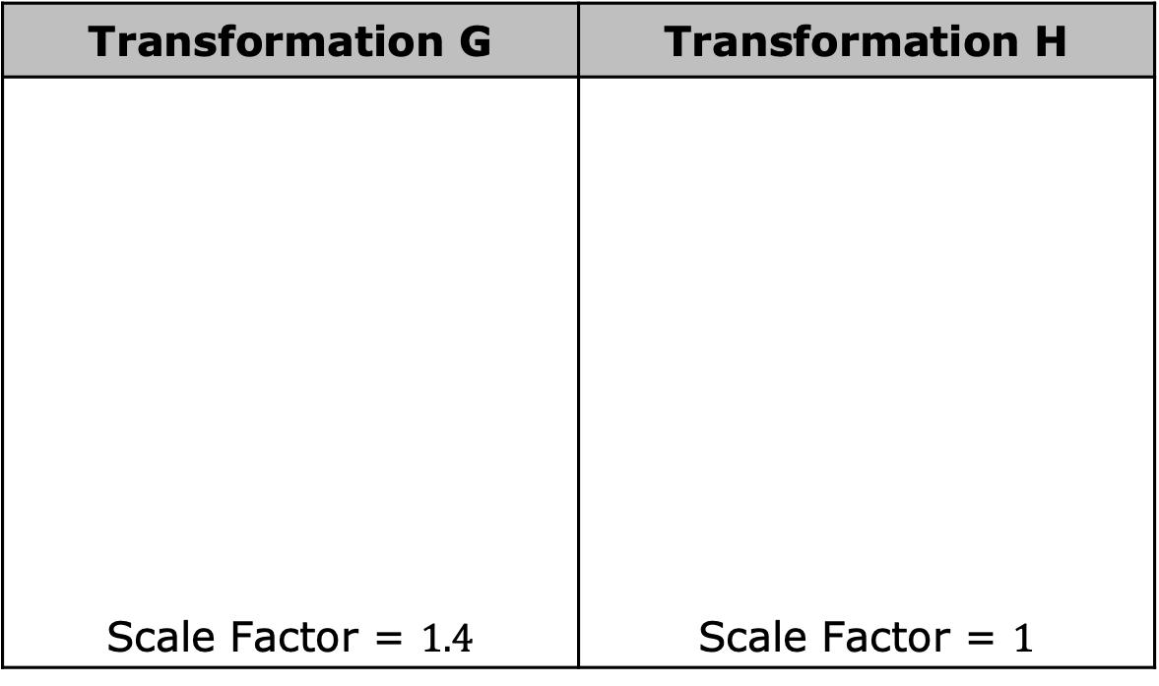
Transformation G | Transformation H
Scale Factor = $1.4$ | Scale Factor = $1$
volume 2, pg. 95

Slide 18

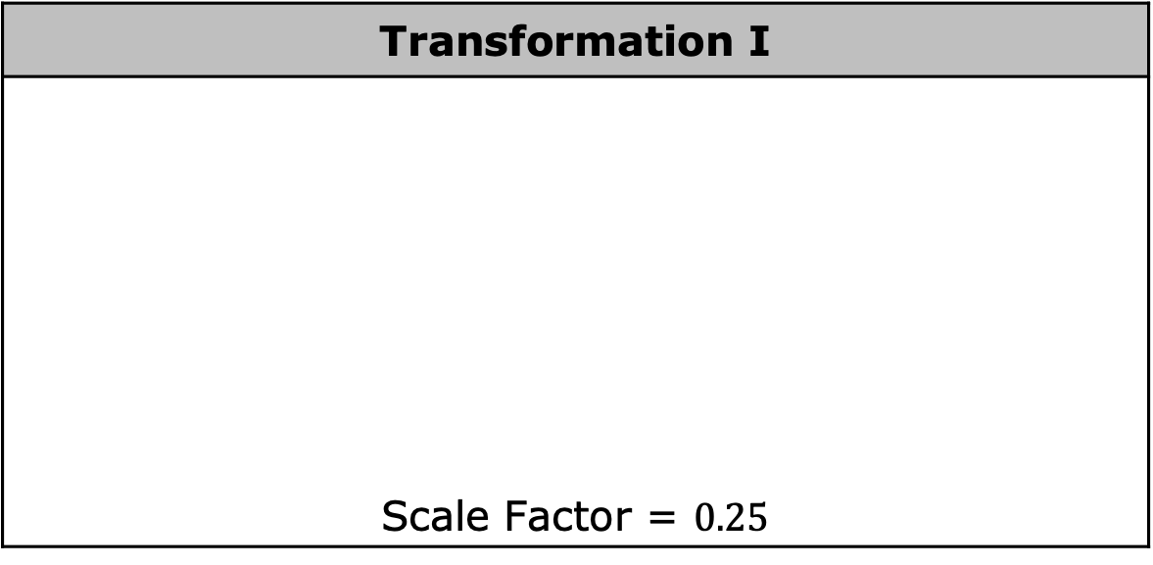
Transformation I
Scale Factor = $0.25$
Discuss with your partner what happens to the image, quadrilateral $FXLH$, as the scale factor changes.
volume 2, pg. 95

Slide 19
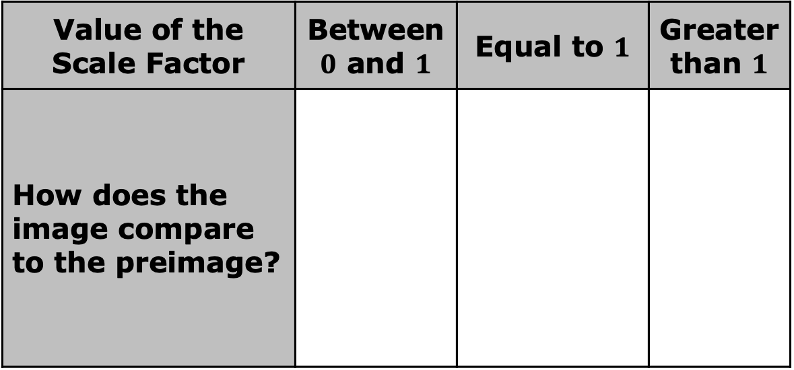
Complete the table.
Value of the Scale Factor | Between $0$ and $1$ | Equal to $1$ | Greater than $1$
How does the image compare to the preimage?
volume 2, pg. 96

Slide 20
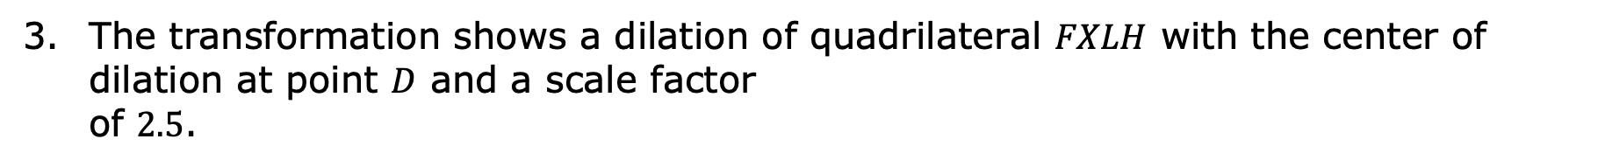
The transformation shows a dilation of quadrilateral $FXLH$ with the center of dilation at point $D$ and a scale factor of $2.5$.
volume 2, pg. 96

Slide 21
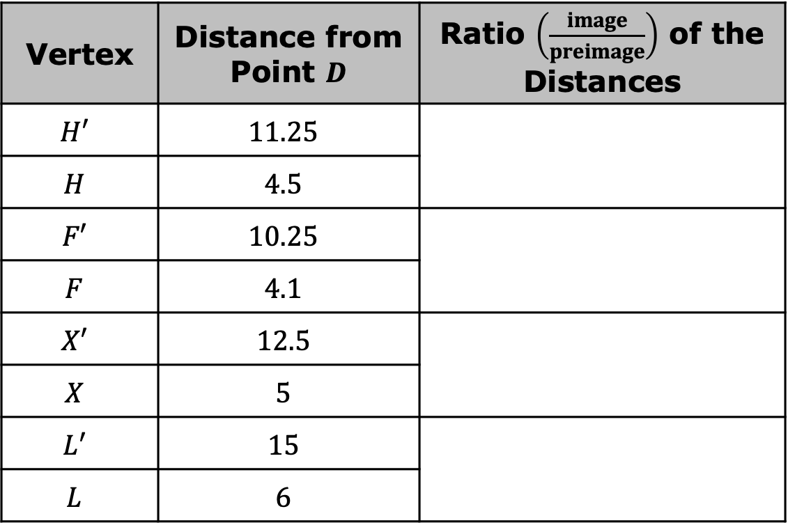

The distance, in units, between the center of dilation, $D$, and each of the vertices of the preimage and image are given in the table. Work with your partner to complete the table.
Vertex | Distance from Point $D$ | Ratio $\left(\frac{image}{preimage}\right)$ of the Distances
$$H′$$ | $$11.25$$
$$H$$ | $$4.5$$
$$F′$$ | $$10.25$$
$$F$$ | $$4.1$$
$$X′$$ | $$12.5$$
$$X$$ | $$5$$
$$L′$$ | $$15$$
$$L$$ | $$6$$
volume 2, pg. 96

Slide 22
Find the value of each ratio in the table using your calculator. What do you notice?
Explain how the ratios of the distances compare to the scale factor of the dilation.
volume 2, pg. 97

Slide 23

Bring It Together
volume 2, pg. 97

Slide 24


9.7.4 Bring It Together: Properties of Dilations
Every dilation has a center of dilation and a scale factor.
In a dilation, the distance of the image to the center of dilation is proportional to the distance of the preimage to the center of dilation. The constant of proportionality is equal to the scale factor.
volume 2, pg. 97

Slide 25
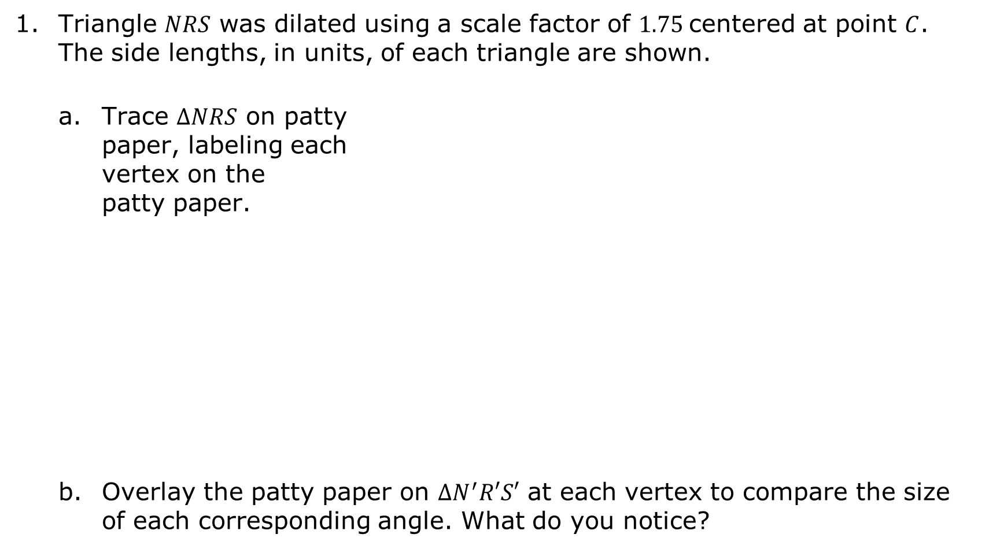
Triangle $NRS$ was dilated using a scale factor of $1.75$centered at point $C$. The side lengths, in units, of each triangle are shown.
Trace $∆NRS$ on patty paper, labeling each vertex on the patty paper.
Overlay the patty paper on $∆N^{′}R′S′$ at each vertex to compare the size of each corresponding angle. What do you notice?
volume 2, pg. 97

Slide 26
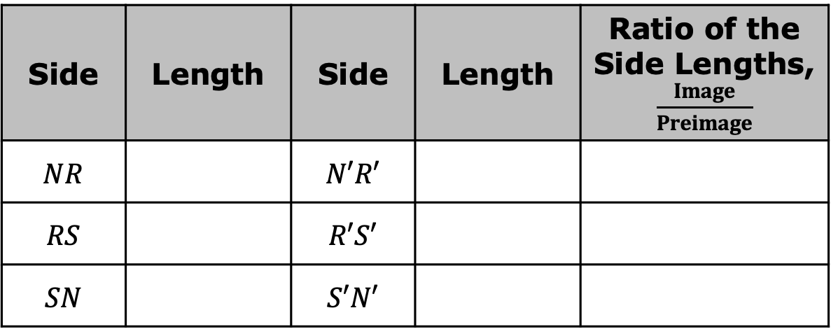
Complete the table using the side lengths of the image and preimage.
Side | Length | Side | Length | Ratio of the Side Lengths, $\frac{Image}{Preimage}$
$$NR$$ |  | $$N′R′$$
$$RS$$ |  | $$R′S′$$
$$SN$$ |  | $$S′N′$$
What do you notice about the side lengths of $∆NRS$ and $∆N′R′S′$?
volume 2, pg. 98

Slide 27

Complete the statements using words from the bank.
After a dilation, the corresponding side lengths of the preimage and image are _____________ and the corresponding angles are _____________. Therefore, the preimage and image are _____________ figures.
congruent
proportional
similar
A dilation is a proportional increase or decrease in size in all directions.
volume 2, pg. 98

Slide 28

Wrap-Up
volume 2, pg. 99

Slide 29
9.7.5 Wrap-Up: Reflection
Complete the table.
The terms and information in the Exploration and Bring It Together that I knew were … | Something I wondered during the Exploration or Bring It Together was … | Something I learned during the Exploration or Bring It Together was …
volume 2, pg. 99

